Slide 1
SERTIFIKASI PRODUK PENGGUNAAN TANDA SNI/KESESUAIAN
BIDANG INDUSTRI
Disampaikan oleh:
Kepala Pusat Standardisasi
Badan Pengkajian Kebijakan, Iklim dan Mutu Industri
Disampaikan pada Workshop 17065
Diselenggarakan oleh Asosiasi Lembaga Sertifikasi Indonesia (ALSI)
Ruang Bisma Lt.2, Hotel Bidakara, Jakarta, 26 Juni 2014

Slide 2
PEMBERLAKUAN SNI SECARA WAJIB BIDANG INDUSTRI
Pemberlakuan SNI Secara wajib
UU No. 8 Thn 1999
UU No. 5 Thn 1984
UU No. 7 Thn 1994
PP No. 58 Thn 2001
PP No. 102 Thn 2000
Permenperin No. 86 Thn 2009
Permenperin Pemberlakuan SNI Secara Wajib
Permenperin Penunjukan LPK
Perdirjen Juknis Pemberlakuan dan Pengawasan SNI Wajib

Slide 3
PEMBERLAKUAN SNI, ST DAN/ATAU PTC SECARA WAJIB BIDANG INDUSTRI
UU No. 8 Thn 1999
UU No. 3 Thn 2014
UU No. 7 Thn 1994
RUU SPK
PP No. 58 Thn 2001
RPP PSPI
RPP
Rpermenperin pengganti Permenperin No. 86 Thn 2009
Permenperin Pemberlakuan SNI, ST dan/atau PTC Secara Wajib
Permenperin Penunjukan LPK
REGULASI TEKNIS
Perdirjen Juknis Pemberlakuan dan Pengawasan SNI, ST dan/atau PTC Secara Wajib

Slide 4
PEMBERLAKUAN SNI, ST DAN/ATAU PTC SECARA WAJIB
Pasal 52
(1) Menteri dapat menetapkan pemberlakuan SNI, spesifikasi teknis, dan/atau pedoman tata cara secara wajib.
(2) Penetapan pemberlakuan SNI, spesifikasi teknis, dan/atau pedoman tata cara secara wajib sebagaimana dimaksud pada ayat (1) dilakukan untuk:
a. keamanan, kesehatan, dan keselamatan manusia, hewan, dan tumbuhan;
b. pelestarian fungsi lingkungan hidup;
c. persaingan usaha yang sehat;
d. peningkatan daya saing; dan/atau
e. peningkatan efisiensi dan kinerja Industri.
(3) Pemberlakuan SNI secara wajib sebagaimana dimaksud pada ayat (1) dilakukan terhadap barang dan/atau Jasa Industri berdasarkan SNI yang telah ditetapkan.
(4) Pemberlakuan spesifikasi teknis secara wajib sebagaimana dimaksud pada ayat (1) dilakukan terhadap barang dan/atau Jasa Industri berdasarkan sebagian parameter SNI yang telah ditetapkan dan/atau standar internasional.
(5) Pemberlakuan pedoman tata cara secara wajib sebagaimana dimaksud pada ayat (1) dilakukan terhadap barang dan/atau Jasa Industri berdasarkan tata cara produksi yang baik.
(6) Setiap barang dan/atau Jasa Industri yang telah memenuhi:
a. SNI yang diberlakukan secara wajib, wajib dibubuhi tanda SNI;
b. SNI dan spesifikasi teknis dan/atau pedoman tata cara yang diberlakukan secara wajib, wajib dibubuhi tanda kesesuaian; atau
c. spesifikasi teknis dan/atau pedoman tata cara yang diberlakukan secara wajib, wajib dibubuhi tanda kesesuaian.

Slide 5
REGULASI TEKNIS
ISO/IEC Guide 2:2004 Standardization and related activities — General vocabulary
technical regulation (3.6.1) is regulation that provides technical requirements, either directly or by referring to or incorporating the content of a standard, technical specification or code of practice
NOTE A technical regulation may be supplemented by technical guidance that outlines some means of compliance with the requirements of the regulation, i.e. deemed-to-satisfy provision.

Slide 6
REGULASI TEKNIS
ISO/IEC Guide 2:2004 Standardization and related activities — General vocabulary
standard (3.2) is document, established by consensus and approved by a recognized body, that provides, for common and repeated use, rules, guidelines or characteristics for activities or their results, aimed at the achievement of the optimum degree of order in a given context
technical specification (3.4) is document that prescribes technical requirements to be fulfilled by a product, process or service
NOTE 2 A technical specification may be a standard, a part of a standard or independent of a standard.
code of practice (3.5) is document that recommends practices or procedures for the design, manufacture, installation, maintenance or utilization of equipment, structures or products
NOTE A code of practice may be a standard, a part of a standard or independent of a standard.
→ SNI
→ ST
→ PTC

Slide 7
Masyarakat Ekonomi ASEAN 2015
ASEAN Economic Community Goal 2015 – Integrasi Ekonomi melalui : Pembentukan pasar tunggal & basis produksi meliputi 5 elemen inti : free flow of goods, services, investments, capital and skilled labour.
Free flow of goods diupayakan melalui : Elimination of Tariffs, Elimination of Non-Tariff Barriers, Rules of Origin (ROO), Trade Facilitation, Customs Integration, ASEAN Single Window.
12 sektor prioritas yang dikembangkan dalam menghadapi pasar bebas MEA : elektronik, produk berbasis agro, produk berbasis karet, produk berbasis kayu, otomotif, tekstil dan produk tekstil, perikanan, pariwisata, kesehatan, jasa penerbangan, e-ASEAN, dan logistik.

Slide 8
Harmonising Standards & Reducing Technical Barriers to Trade
ASEAN Consultative Committee on Standards & Conformance (ACCSQ) was set up to:
Implement mutual recognition arrangements (MRAs) of test reports, certifications & conformity
Harmonise national standards, technical regulations & conformity assessment requirements
Supported by 3 working groups (WGs)
WG1 – Working Group on Standards and Mutual Recognition Arrangements
WG2 – Working Group on Accreditation and Conformity Assessment
WG3 – Working Group on Legal Metrology
9 product working groups (PWGs)
JSC EE MRA - Joint Sectoral Committee for ASEAN Sectoral MRA for Electrical and Electronic Equipment
ACC – ASEAN Cosmetic Committee
PPWG – Pharmaceutical Product Working Group
PFPWG – Prepared Foodstuff Product Working Group
APWG – Automotive Product Working Group
TMHSPWG – Traditional Medicines and Health Supplements Product Working Group
MDPWG – Medical Device Product Working Group
WBPWG – Wood-Based Product Working Group
RBPWG – Rubber-Based Product Working Group

Slide 9
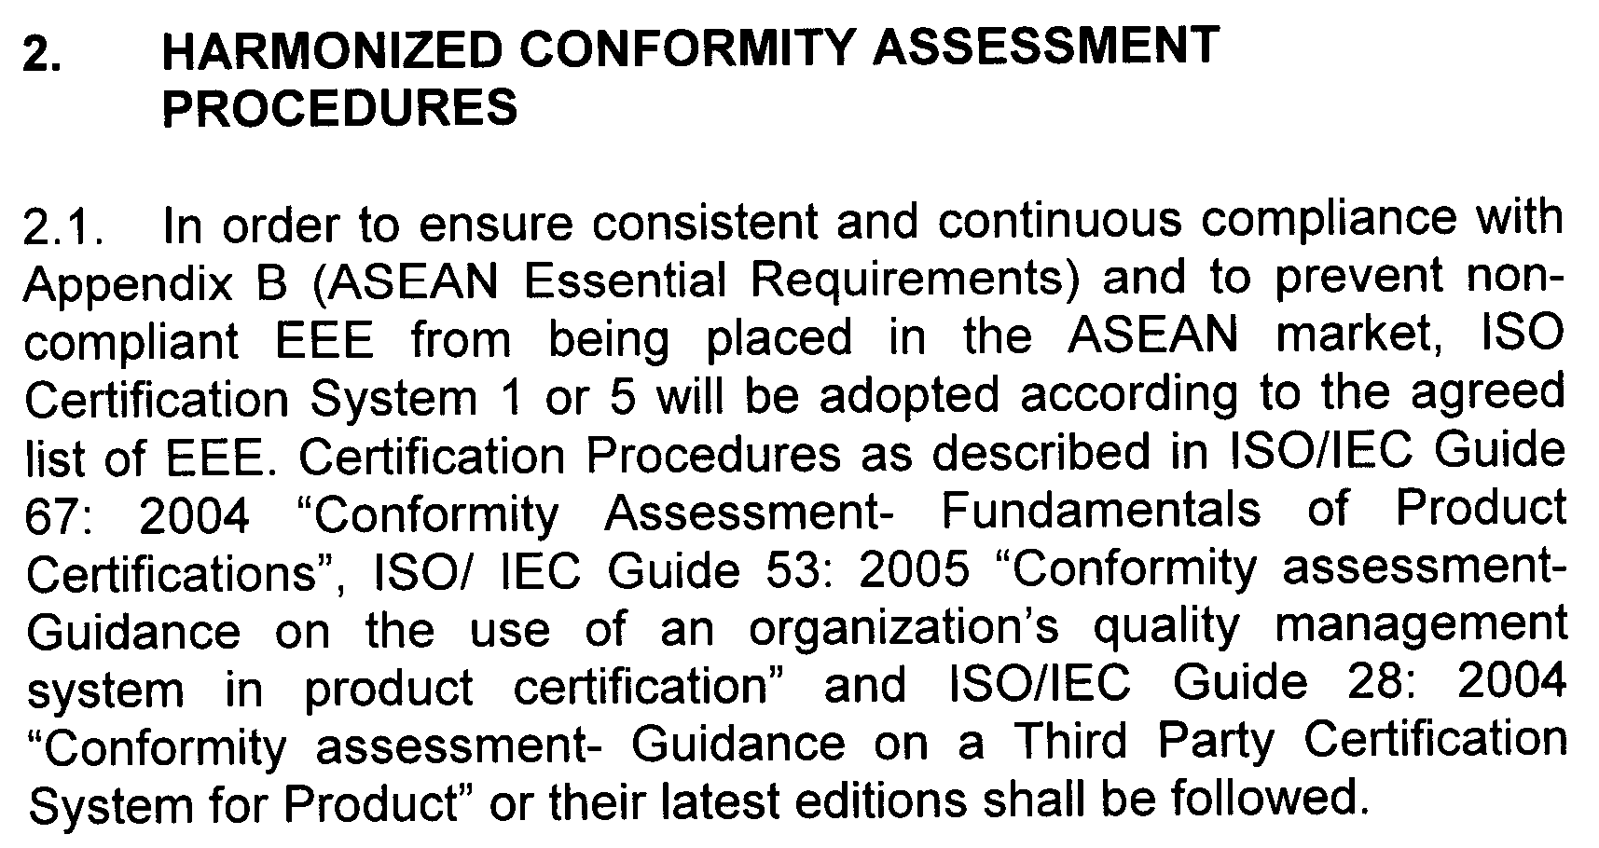
AGREEMENT ON THE ASEAN HARMONIZED ELECTRICAL AND ELECTRONIC EQUIPMENT (EEE) REGULATORY REGIME

Slide 10
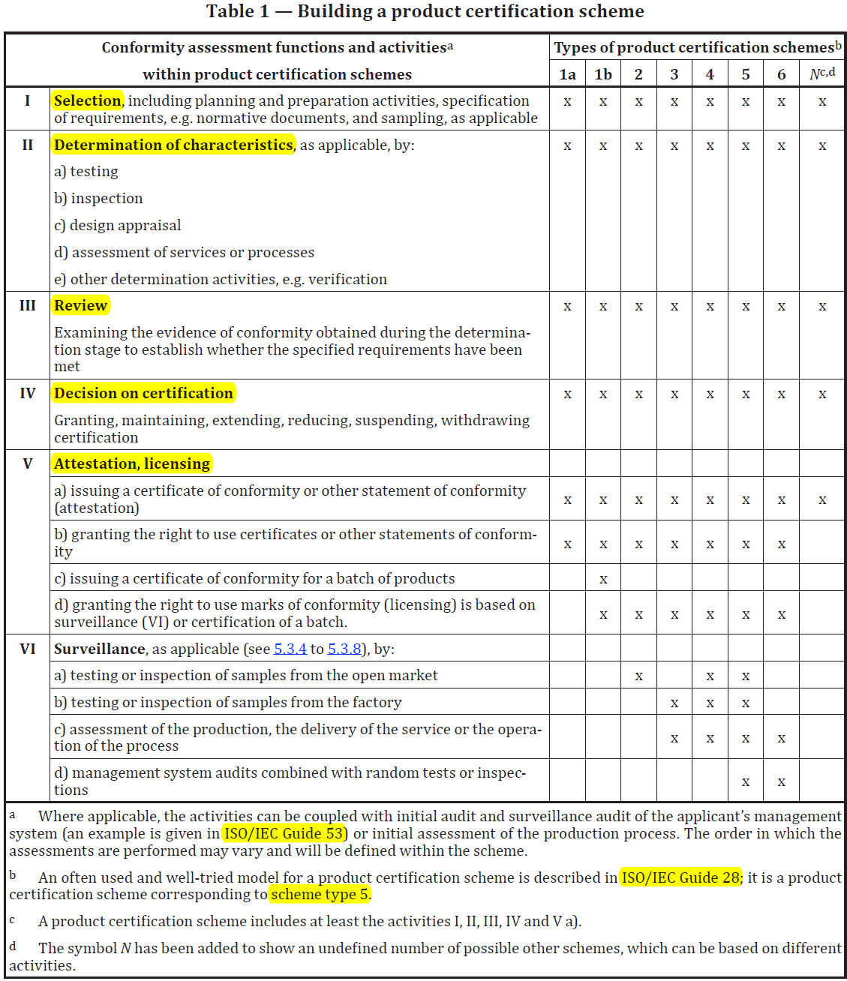

Slide 11
5.3 Types of product certification schemes
5.3.3 Scheme type 1b
This scheme type involves the certification of a whole batch of products, following selection and determination as specified in the scheme. The proportion to be tested, which can include testing of all the units in the batch (100% testing), would be based, for example, on the homogeneity of the items in the batch and the application of a sampling plan, where appropriate. If the outcome of the determination, review and decision is positive, all items in the batch may be described as certified and may have a mark of conformity affixed, if that is included in the scheme.
5.3.7 Scheme type 5
The surveillance part of this scheme allows for the choice between periodically taking samples of the product either from the point of production, or from the market, or from both, and subjecting them to determination activities to check that items produced subsequent to the initial attestation fulfil the specified requirements. The surveillance includes periodic assessment of the production process, or audit of the management system, or both. The extent to which the four surveillance activities are conducted may be varied for a given situation, as defined in the scheme. If the surveillance includes audit of the management system, an initial audit of the management system will be needed.

Slide 12
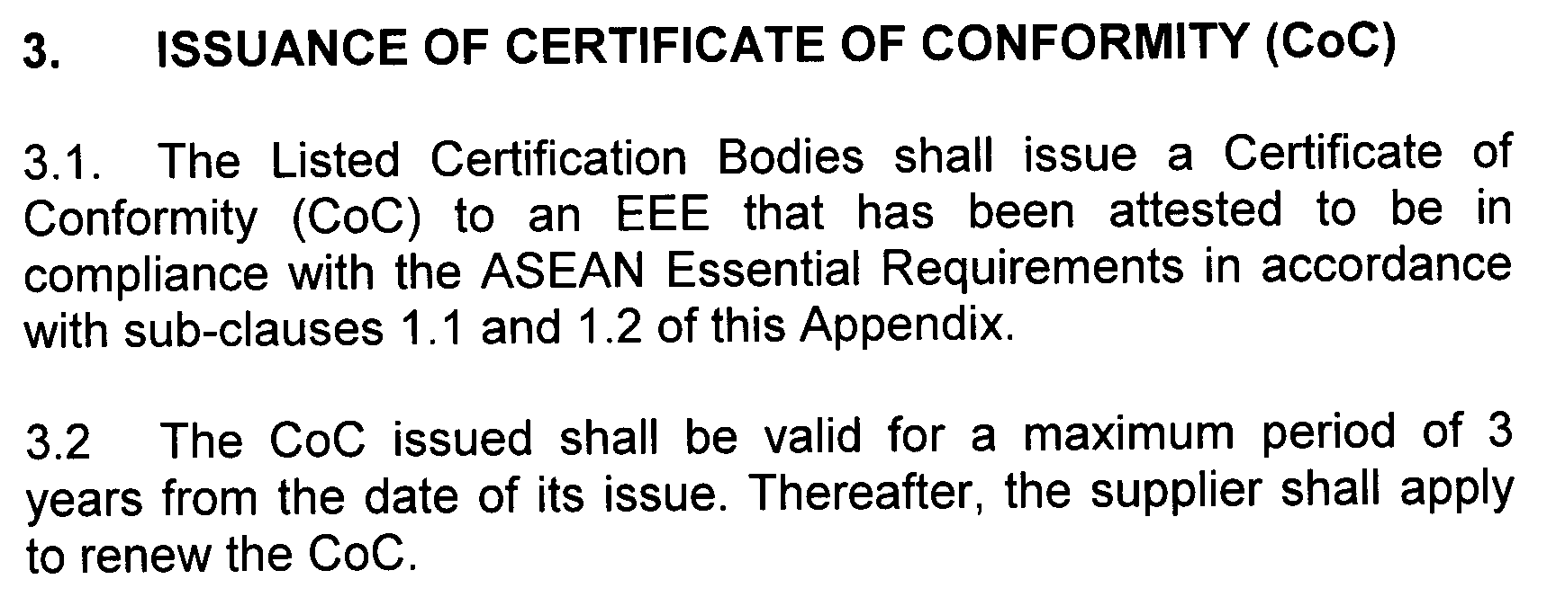
AGREEMENT ON THE ASEAN HARMONIZED ELECTRICAL AND ELECTRONIC EQUIPMENT (EEE) REGULATORY REGIME

Slide 13
PENGAWASAN SNI, ST DAN/ATAU PTC
Pengawasan dilakukan di seluruh rangkaian rantai pasokan (supply chain)
Penarikan barang
Sistem Safety Alert
Produsen DN
Pengecer
(Retailer)
Distributor
(Wholesaler)
PSI
Produsen LN
Importir
Pengawasan
di Kawasan Pabean
UU No.3 Tahun 2014 tentang Perindustrian

Slide 14
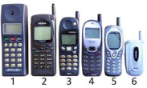
PENENTU DAYA SAING PERUSAHAAN INDUSTRI
PERSYARATAN REGULASI TEKNIS
[TBT/SPS WTO]
PERSYARATAN PEMBELI
Konsumen / Industri / Pemerintah
PERSYARATAN PASAR
[TINGKAT MUTU]
INFRASTRUKTUR MUTU
KESESUAIAN
KEMAMPUAN PERUSAHAAN INDUSTRI
[TINGKAT MUTU]
Teknologi
Manajemen Produksi
SCM
HRM
Pengembangan Produk

Slide 15
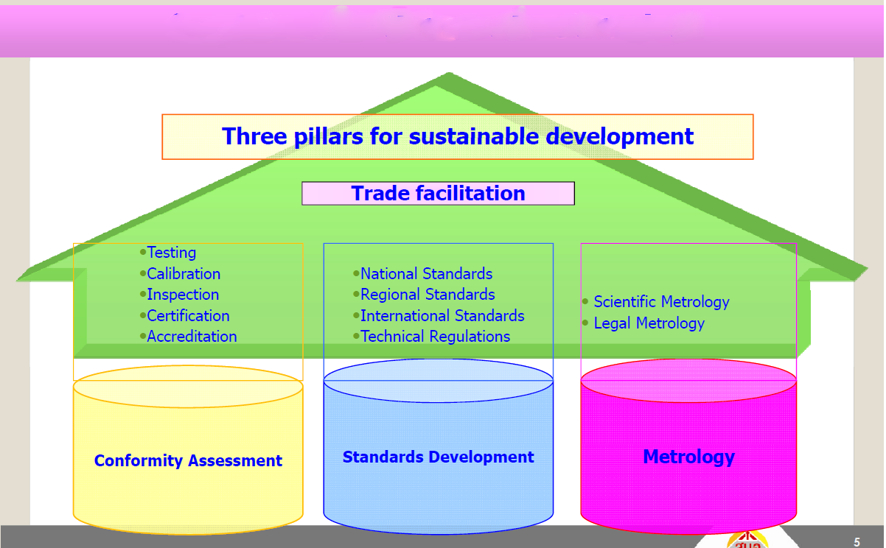
Quality Infrastructure
Facilitation for free flow of goods and services
Industrial Metrology
Conformity Assessment
Standards Development
Metrology

Slide 16
PERMASALAHAN SERTIFIKASI PRODUK
Waktu audit yang berbeda untuk ukuran dan tipe perusahaan yang serupa
Pengambilan sampel berbeda untuk kategori produk yang sama
Pola pensubkontrakan antara LSPro dan Lab. Uji yang tidak sesuai ketentuan KAN dan/atau Regulasi Teknis
Penanggung jawab lebih dari satu untuk merek yang sama

Slide 17
SOLUSI
Regulator menetapkan skema sertifikasi produk penggunaan tanda SNI / Kesesuaian
Diperbolehkan dalam ISO/IEC 17067:2013

Slide 18
TERIMA KASIH

